Slide 1



CS4352 Operating Systems
Lecture 4
Instructor: Yong Chen, Ph.D.
Assistant Professor
Department of Computer Science
Texas Tech University
Tommy Dang made minor modifications on the slides

Slide 2
Outline
Questions?
System Calls
Concept and steps
System calls for process, file, and directory management
Operating System Structure
Notes:
Why need system calls

Slide 3
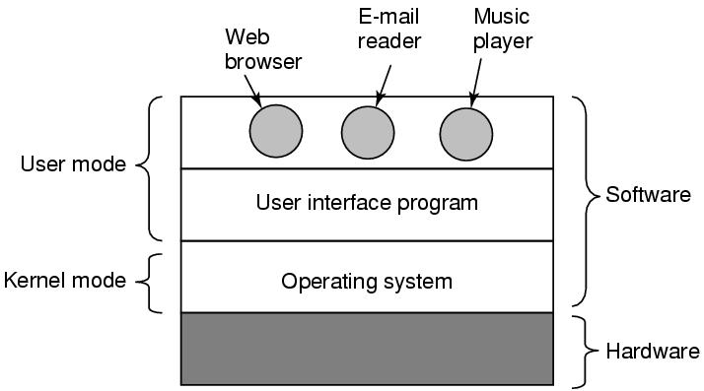
Figure 1-1. Where the operating system fits in.

Slide 4
System Calls
Interface between user programs and OS
Vary among operating systems
POSIX (Portable Operating System Interface)
A family of standards specified by the IEEE
Defines system calls API (Application Program Interface), command line shells, and utility interfaces
POSIX has about 100 procedure calls (some examples are listed in the Fig. 1-18) on page 54.

Slide 5
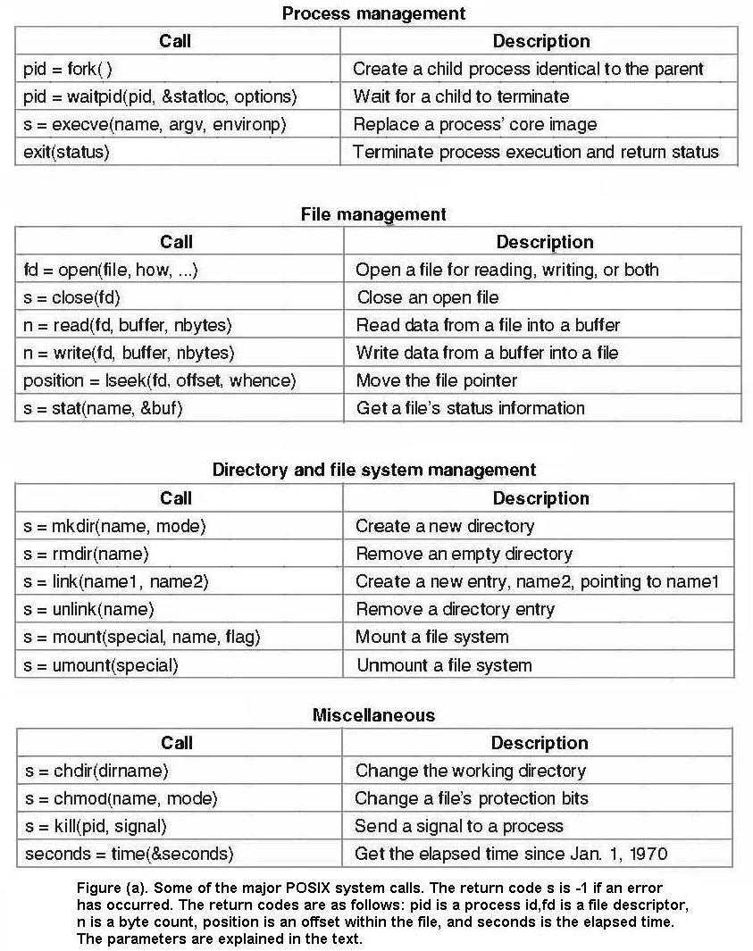

Slide 6
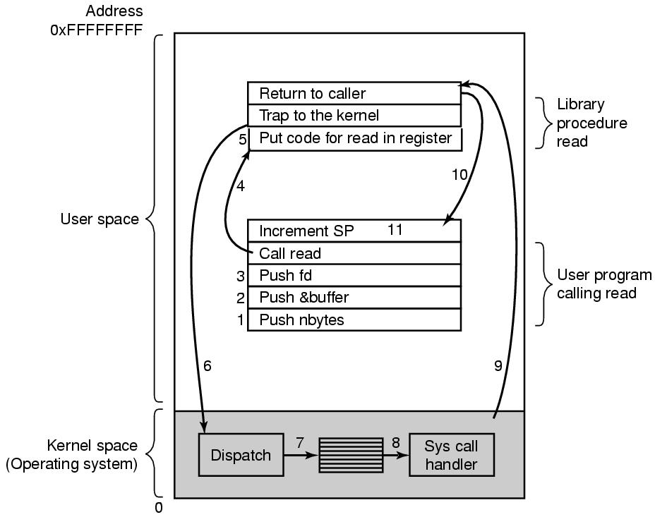
Steps of System Calls
read system call
count=read(fd, buffer, nbytes)
(count can be smaller than nbytes. Why?)
If an error occurs, count is set to -1 and the error number is put in errno (a global variable)
(The program should always check)
Figure 1-17. The 11 steps in making the system call read(fd, buffer, nbytes).
Notes:
fd and nbytes are by values while buffer is passed by reference
Why the system call parameters are pushed to the stack in the reverse order? -> Historical reason.

Slide 7
Notes
C/C++ languages
Pass by value
Pass by reference
Notes:
Comparing to procedure call

Slide 8
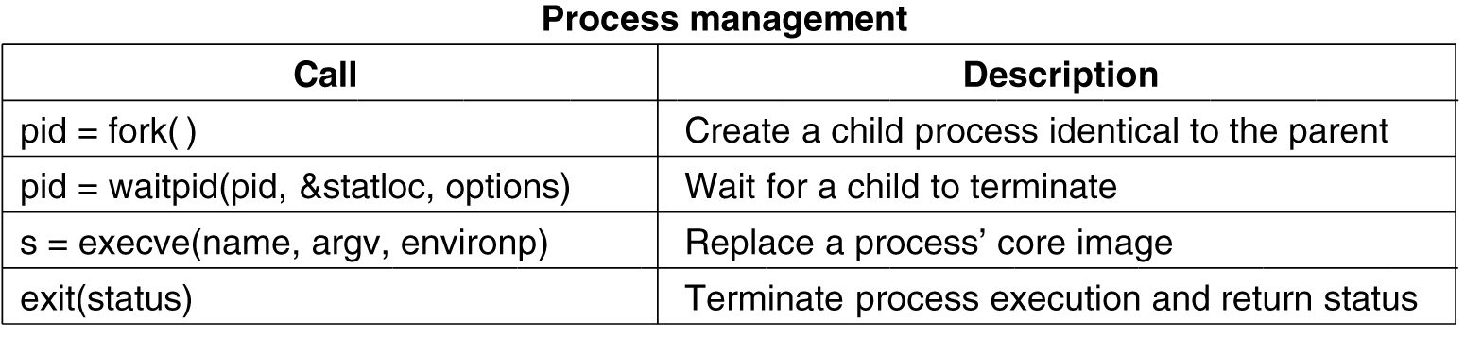
System Calls for Process Management
Figure 1-18 (a). Some of the major POSIX system calls.

Slide 9
A Simple Shell
Figure 1-19. A stripped-down shell.
Notes:
Status is the status of the child process.
-1: Wait for any child

Slide 10
Memory Layout
Figure 1-20. Processes have three segments: text, data, and stack.
Notes:
A text segment is also known as a code segment, a text segment is placed below the heap or stack in order to prevent heaps and stack overflows from overwriting it.
The text segment is read-only and sharable so that only a single copy needs to be in memory for frequently executed programs, such as text editors
Initialized data segment, called simply the Data Segment.
A data segment is a portion of virtual address space of a program, which contains the global variables and static variables that are initialized by the programmer.
Data segment is not read-only.
Uninitialized data starts at the end of the data segment and contains all global variables and static variables that are initialized to zero or do not have explicit initialization in source code.

Slide 11
Figure 1-20. Processes have three segments: text, data, and stack.
Notes:
The stack grows the opposite direction of heap
When the stack pointer met the heap pointer, free memory was exhausted. What happen?
A “stack pointer” register tracks the top of the stack; it is adjusted each time a value is “pushed” onto the stack.
Each time a function is called, the address of where to return to and certain information about the caller’s environment, such as some of the machine registers, are saved on the stack. The newly called function then allocates room on the stack for its automatic and temporary variables.
Heap is the segment where dynamic memory allocation usually takes place.
The heap area begins at the end of the BSS segment and grows to larger addresses from there. The Heap area is managed by malloc, realloc, and free
http://www.programmingsimplified.com/c-program-examples

Slide 12
System Calls for File Management
Figure 1-18 (b). Some of the major POSIX system calls.

Slide 13
System Calls for Directory and File Management
Figure 1-18 (c). Some of the major POSIX system calls.

Slide 14
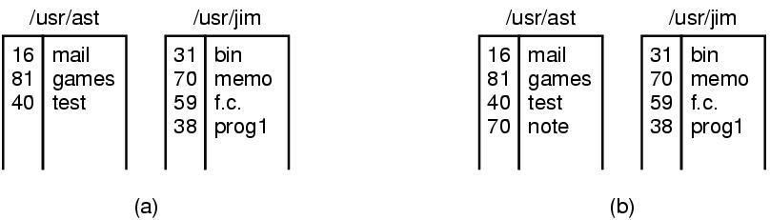
Linking
link(“usr/jim/memo”, “usr/ast/note”)
Figure 1-21. (a) Two directories before linking /usr/jim/memo to ast’s directory. (b) The same directories after linking.
Notes:
In the figure (b), two entries have the same i-number (70) and thus refer to the same file.
If either of them remove using unlink system call, what happen? -> the other one remains.
If both remove, the file is removed from the disk.
For a struct without pointers (or other reference types), there is no difference between a deep and a shallow copy because the data structure it itself shallow.
http://stackoverflow.com/questions/6911688/c-making-a-deep-copy-of-a-struct-making-a-shallow-copy-of-a-struct

Slide 15
Miscellaneous System Calls
Figure 1-18 (d). Some of the major POSIX system calls.

Slide 16
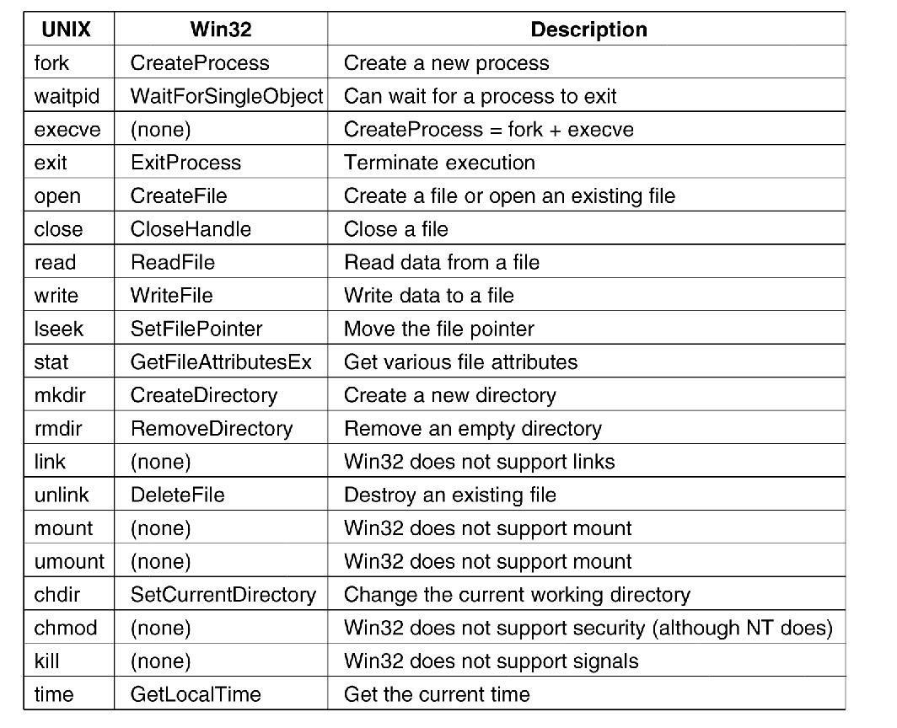
Windows Win32 API
Figure 1-23. The Win32 API calls that roughly correspond to the UNIX calls of Fig. 1-18.

Slide 17
Readings
Chapter 1:
Section 1.6

